Slide 1
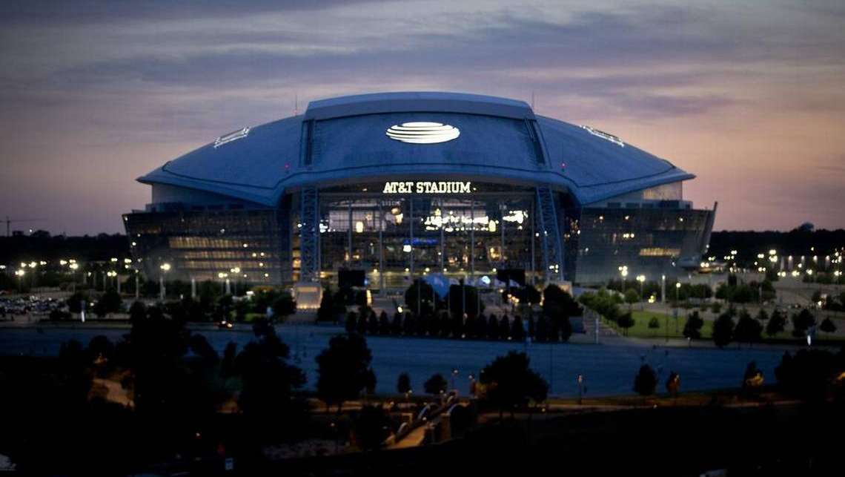


Team 4
Macy Lee, Roberto Lemus, Ian Lindstrom, Logan Thompson
Coach: Teagan Haberkorn

Slide 2

Roadmap
Objectives
Target Audience and Segments
Positioning
Promoting and Expediting with NIL
GYCB Outline
Three-Week Marketing Plan
Budget
Conclusion

Slide 3
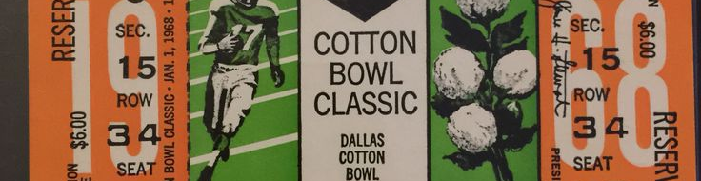
Objectives
Increase ticket sales by 15,000 new sales
Promote the game with NIL
Create entertainment value

Slide 4
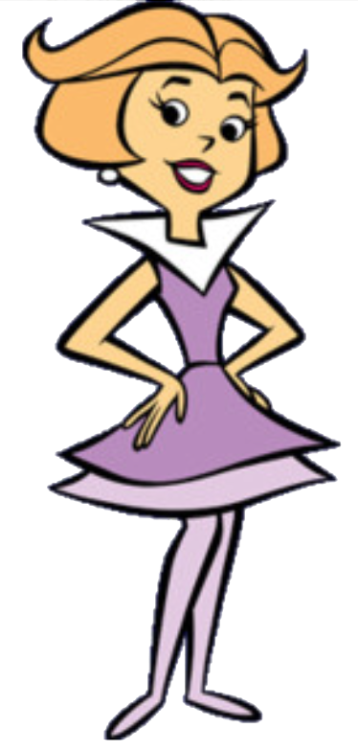
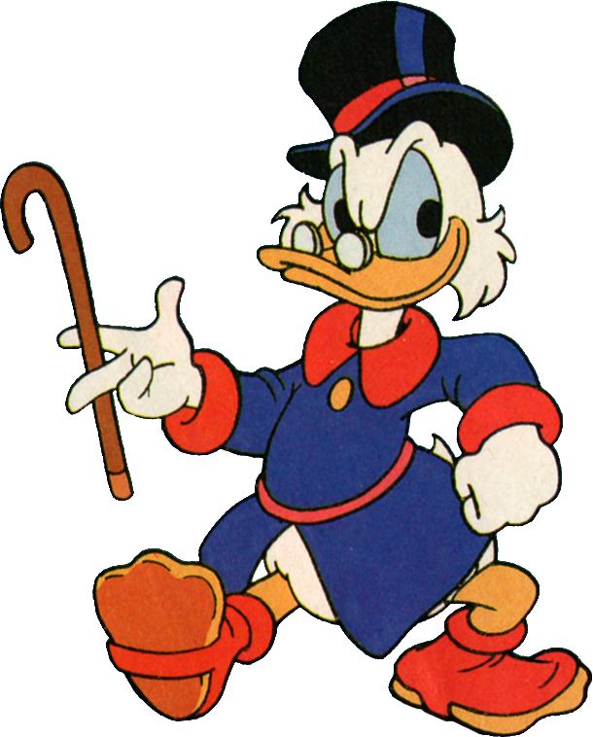
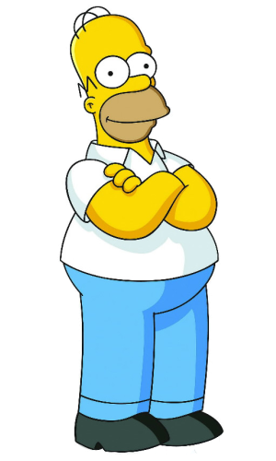
Target Audience & Characterization
Homer Simpson: The Overall Texas Market
Passionate About Their Hobbies
Middle Income
Not Willing to Spend a lot
Mostly Male
Scrooge McDuck: The Travelling CFB Fan
Older Demographic
Higher Income
Willing to Travel
Jane Jetson: The Dallas Market
Middle-aged
High Income
Cares About New Trends
Confident Spender

Slide 5
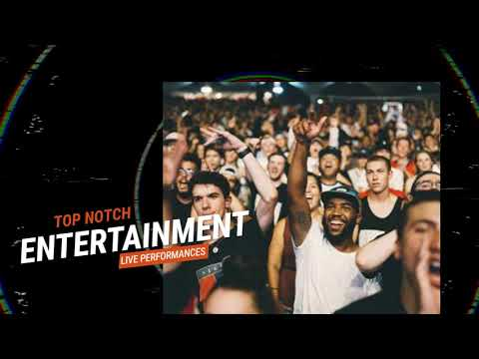
Positioning Statement
To the entertainment seekers, the Goodyear Cotton Bowl is the bowl game that extends the new year celebration by combining sports and entertainment into the can’t miss the event of the year!

Slide 6
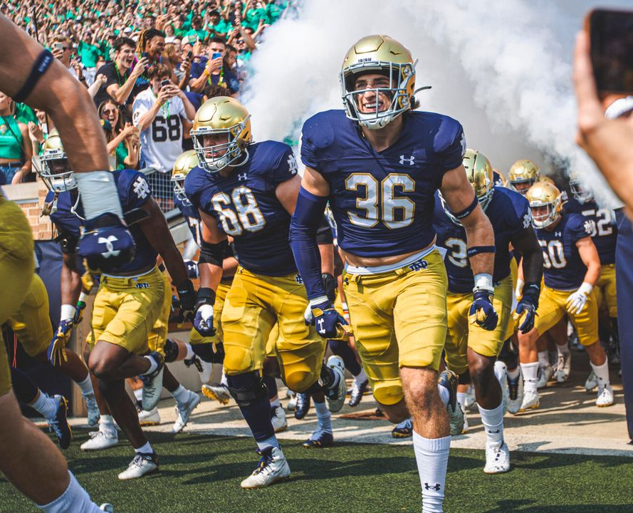
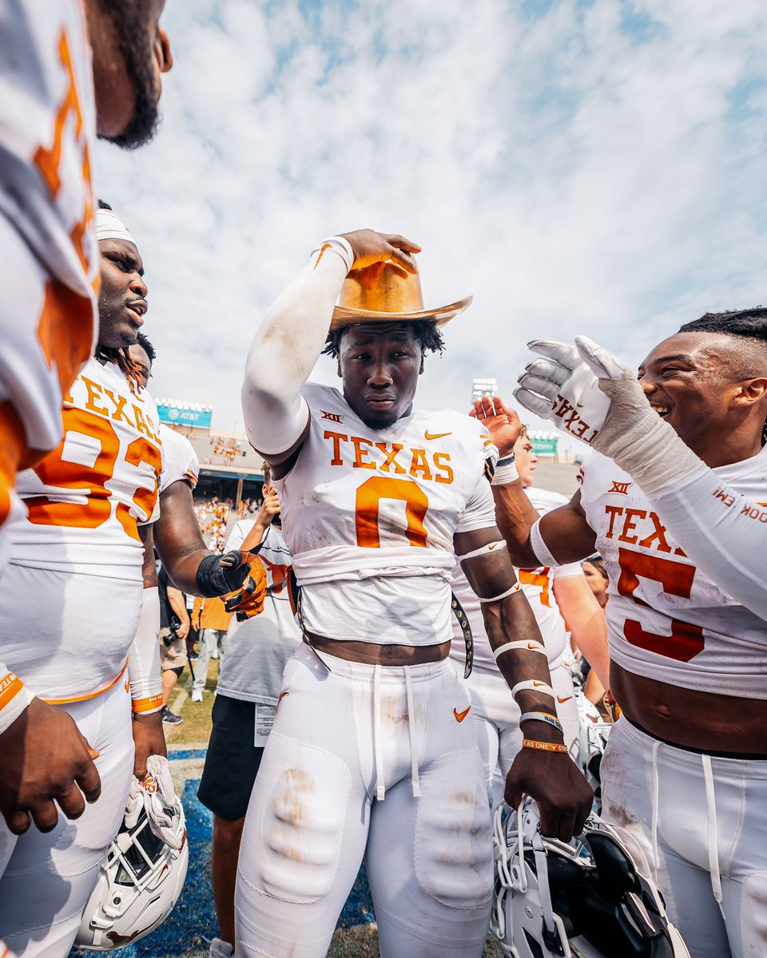
Fighting Irish
VS
Longhorns

Slide 7
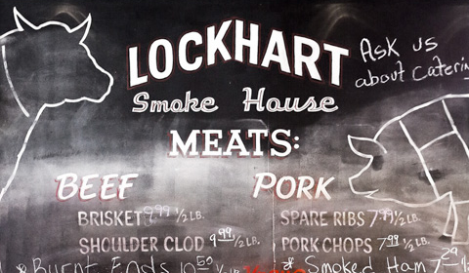
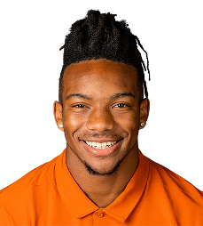

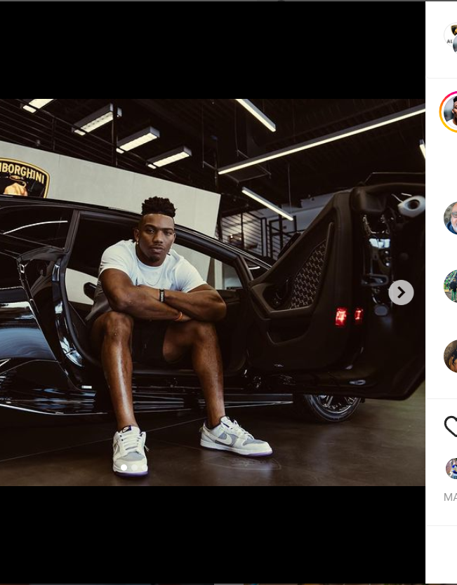
Local Business NIL deals to Promote and Profit
What a potential partnership could look like?

Slide 8

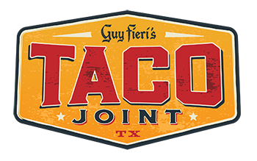
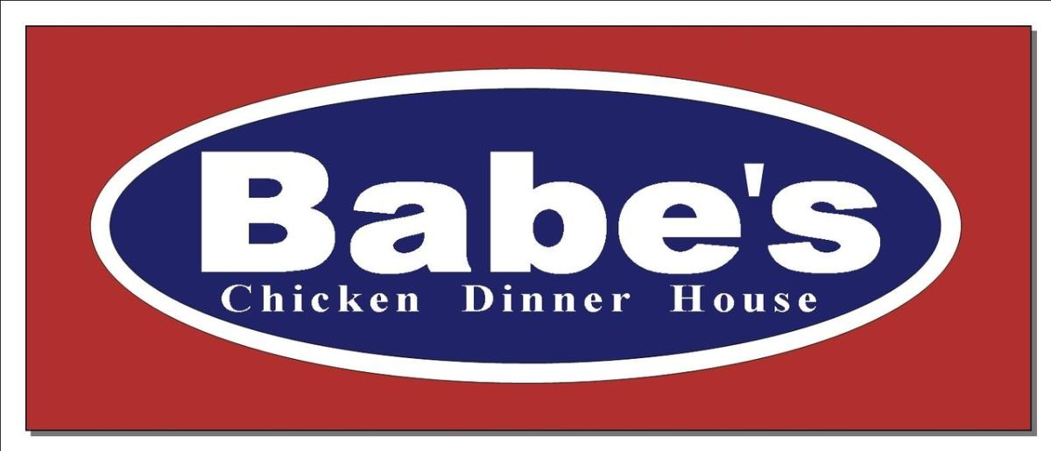

Partnerships within Texas Live and Dallas-Ft Worth Area

Slide 9
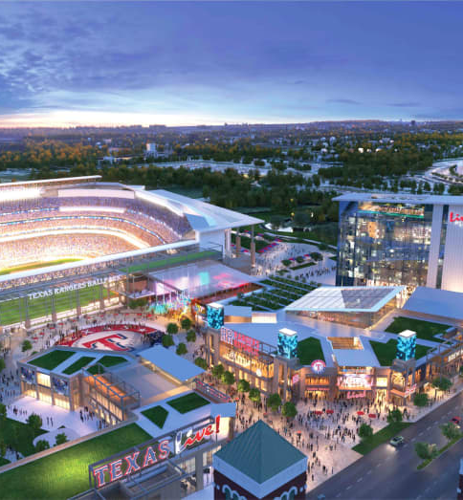
Post-Game Partnership with Texas Live!
Texas live is a restaurant and entertainment complex that can provide the fans with post-game meals and quality time.

Slide 10
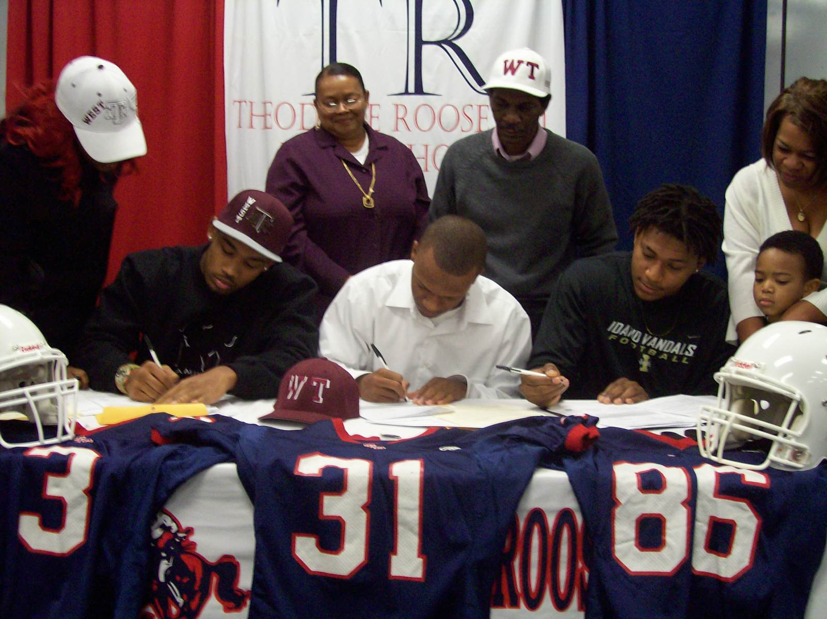
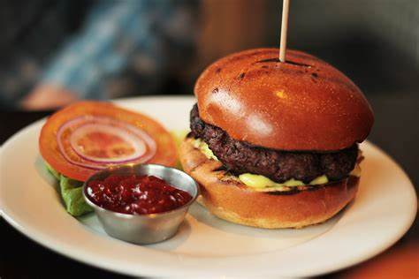
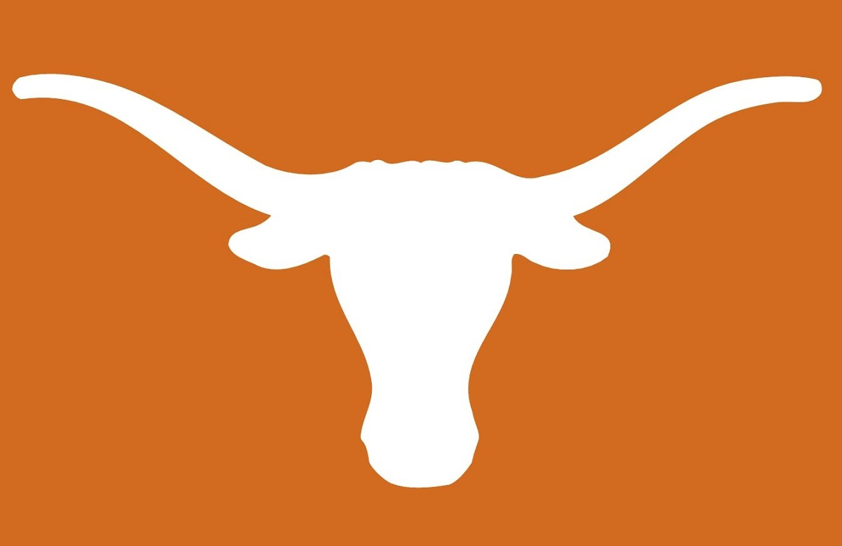

Utilizing Opted-Out Star Players
Meet-and-greets
Autograph Signings
NIL partnership with local companies
Unique named product vs. standard player contract

Slide 11
NIL Expedited Process
Getting in contact with compliance/agents to get approval for potential players
Pitching those deals to select athletes immediately
Partnering with local businesses to fill out contracts prior to knowing the athletes involved

Slide 12




GYCB Extended New Years' Experience
Prior day
During game
Pregame
Post-game

Slide 13
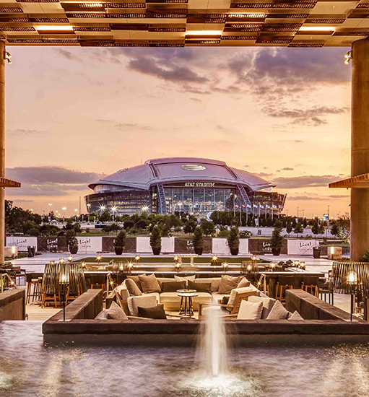
Prior Day (Sunday, 1/1)
Local band concert
Star players meet and greet
Football related activities for kids
Private access for local high school teams and special fans
Food trucks with partnered restaurants
Notes:
We are going to approach restaurants located in the Live Lowe's Arlington center located down the street from the stadium with opportunities to draw in large consumer crowds to their establishments. Through coupons included with a paid ticket to the game, fans will get to experience discounted meals at live lowe's arlington. NIL comes into play in bringing the athletes into these markets. Athletes will receive an independent code that they will then send out for fans to use at local restaurants to receive discounts. The athletes will then receive a portion of the sales so this will incentivise them to promote the restaurant with their specific code.

Slide 14
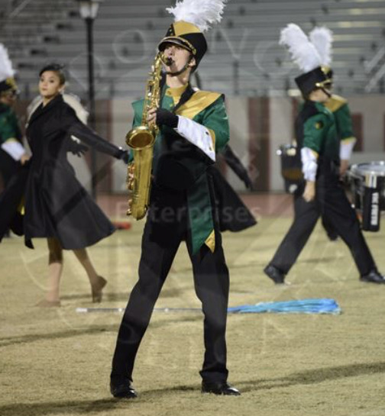
Pre-Game Band Performance
In stadium, 10 local high school teams play together
Average Texas HS marching band size is 300 (txbands.com)
Average of 3 members per band student
9000 ticket sale pull with families coming to see their students perform

Slide 15
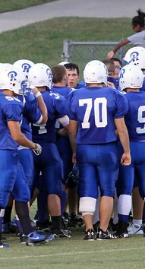
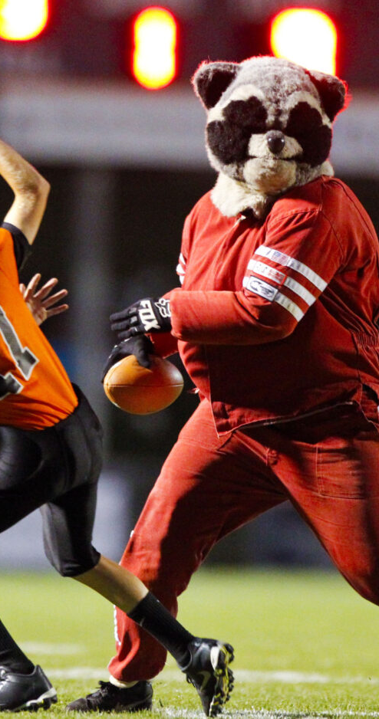
Halftime
Local football teams recognized on the field
Chance for players to be on the turf during the halftime game
Mascot football game between high school and college teams

Slide 16
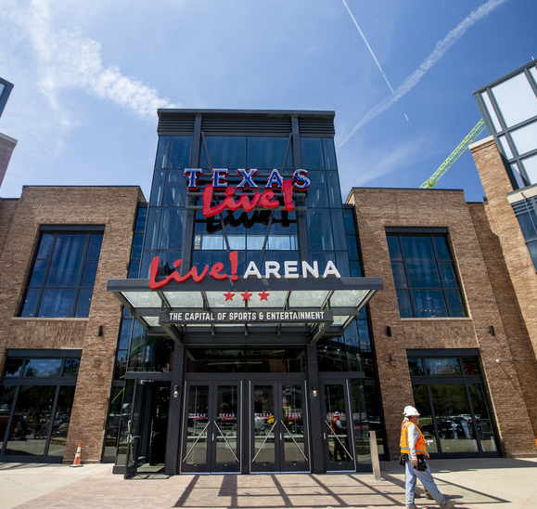
Post-Game
Texas Live!
Partnerships with local companies to kick off the night
Discounts and positive social environment

Slide 17
Three-Week Marketing Plan: Dec. 12
White: NIL Agreements
Green: Event Operations
Orange: Promotions
1 Contact all NIL Partner Businesses Contact local markets Begin tech promotions | 2 Finalize NIL Deal & Contracts with LC Continue outreach to local bands Engage excitement through what is to come over the 2-day event | 3 ---------> ---------> Continue to excite the audience through the multi-day event | 4 ---------> ---------> ---------> | 5 Finalize contracts & pitch to athletes Gauge final interest on what local bands have interest Launch the initiative on the bowl game being "The Extended New Years Celebration" | 6 Continue to pitch contracts & negotiate with athletes Give last call on what bands will take part in the show Create continued excitement for the ultimate party to be at | 7 Begin to get player signatures on contracts Finalize list of local bands performing Release the list of the bands and engage excitement through that list
8 ---------> Prepare music that all bands will be playing in unison Start to profile local bands that will be performing | 9 Begin getting players acclimated with the local businesses Ensure bands are set with their music ---------> | 10 Start player advertising process & posting schedule Begin outreach to obtain local football teams & their families to the games ---------> | 11 ---------> ---------> Begin to highlight the local football teams involved for halftime | 12 Players begin posting on social media (first wave) Keep constant communication with the bands on any accommodations needed ---------> | 13 ---------> ---------> Begin efforts to highlight actual players in the game | 14 ---------> Reach out to charter buses to ensure everything is in place Talk about efforts in social media for what the players are doing in the community
15 Players continue to market through social media & ads Begin setup and placing signage for the band performances Begin countdown to game | 16 Second large wave of posting begins Continue setup of the plaza and the stadium Continue countdown to game along with top highlights | 17 ---------> ---------> ---------> | 18 Continue to engage with the fans & bring brand awareness Reach out to all bands one more time to ensure everything is in place Recap the pregame, midgame and postgame activities | 19 ---------> ---------> Final marketing efforts along with last minute ticket packages | 20 Final wave of posting before gameday, exciting the fans Ensure the plaza is ready and the stadium is still equipped to handle all bands Get the fans excited for the player arrivals and everyone arriving at the stadium | 21 Last minute engagements that may pop up for the athletes Finalize last minute setup before gameday Typical gameday marketing activities with player and activity content

Slide 18
Budget Breakdown Total: $30,000
Advertising campaigns: $5,000
Local bands: $10,000
Transportation- $500 per high school, $5,000
Autograph sessions and meet and greets: $5,000
Prior-day budgeting: $5,000

Slide 19
Ticket Sales Increased
Past Non-Semi Game: 54,828
Goal:
70,000
Add 15,000 ticket sales
Marching Band Fans: 9,000
High School Fans: 1,600
New Pulled in Fans: 4,000
Traveling Team Fans: 600
Unpurchased Performers: 4,000
Total New Tickets Sold: 15,200
Total New Bowl Attendance: 74,000

Slide 20
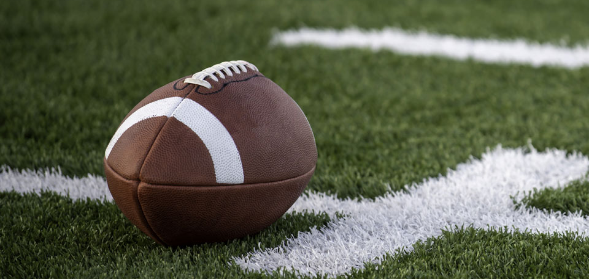
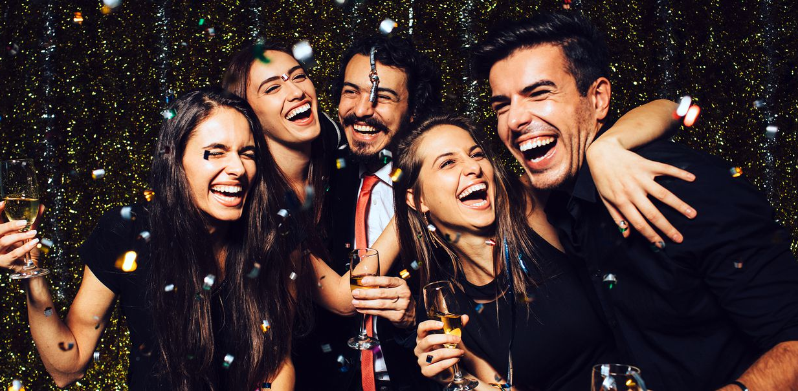
Conclusion
Increase total ticket sales to 70,000 on a low level budged
Top notch New Year Marketing outlook combining entertainment and sports
Two-day event to bring buzz around the stadium before, during, and after the game
Combine NIL partnerships with local restaurants

